Slide 1

Movie Recommendations
Aashi, Akshaya, Harshit, Alisha, Tyler

Slide 2

Table of Contents
01
02
03
04
Problem Statement
Pre - Processing
Data sources, Frequency of Important Words
Analysis
Insights and Recommender System
Lift Scores, Topic Modeling, Sentiment Analysis
User generated feedback

Slide 3

01
Problem Statement

Slide 4

Problem Statement
Thousands of movies across multiple streaming platforms… How do you know which one to pick to watch?
Every movie watcher has a different opinion
Create a recommender system by scraping IMBD.com to filter movie reviews and ratings
Generates recommendations based on user input attributes

Slide 5
02
Pre-Processing

Slide 6
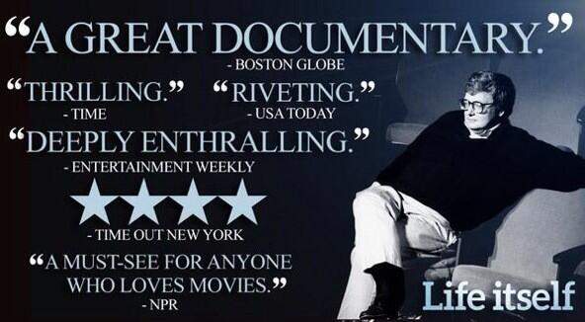
Data Pre-Processing
IMDB.com
Scraped 10,000 movies and TV shows along with ratings
Movies/shows rated on a 1-10 scale

Slide 7
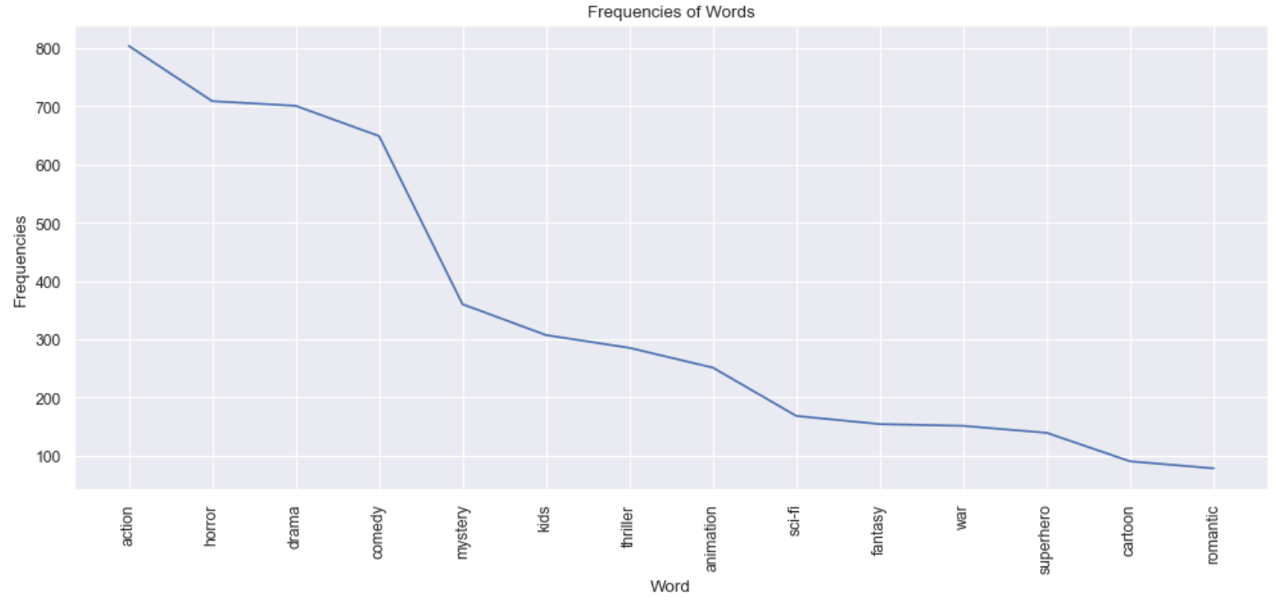
Data Pre-Processing
Majority of descriptive reviews feature action, horror, drama, and comedy
Sharp drop off for word frequency for the rest of the genres
Can conclude that most watched movies reside in those four genres
Figure 1 : Word Frequency Count for Genres

Slide 8
03
Data Analysis

Slide 9
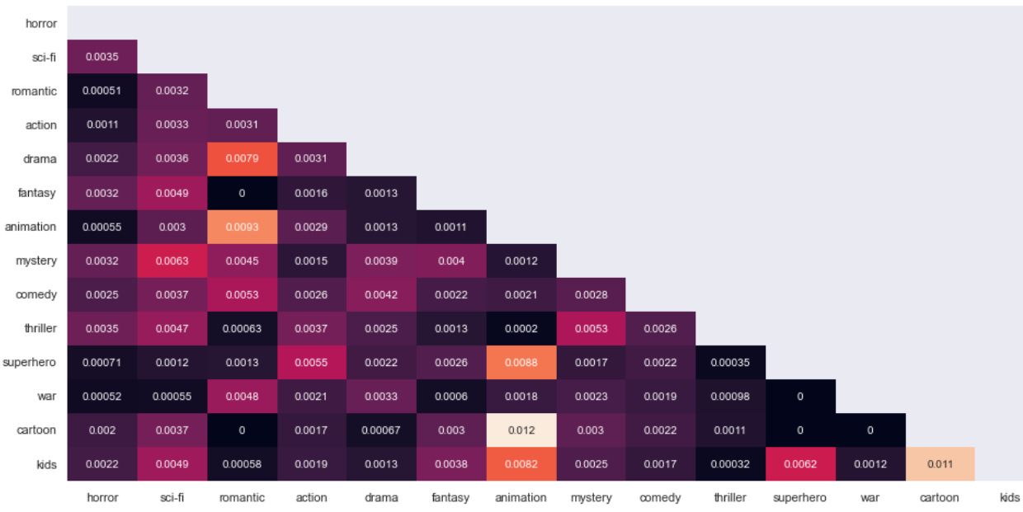
Analysis
Animation has highest lift scores with Romantic, Superhero, Kids, & Cartoon
Romantic has highest lift scores with Drama, Animation & Comedy
Zero lift scores with cartoon and thriller genres
Sci-fi has highest lift scores with Mystery & Fantasy
Overall, lift scores are accurate to prior assumptions about movie genres
Figure 2 : Lift values between different genres

Slide 10
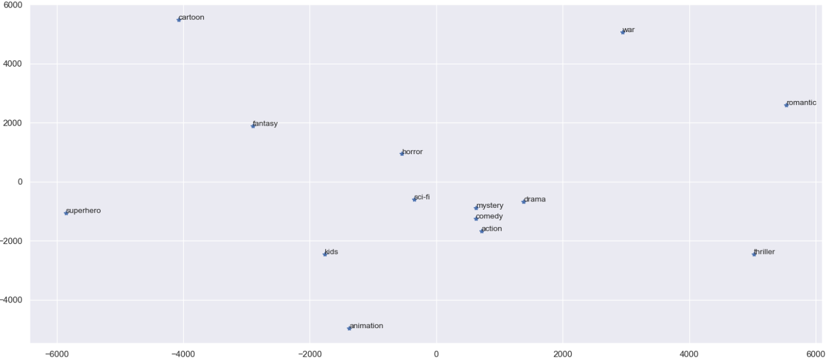
Analysis
Mystery, Comedy, Action, Sci-fi, and Drama are clustered
These genres often overlap within movies
Inception
Animation, Kids, Superhero, and Sci-fi are grouped closely together
Kids movies are often animated
Figure 3: MDS Of How Different Genres Are Related

Slide 11
04
Insights and Recommender System

Slide 12

Insights and Recommender System
Takes list of attributes that the user wants to see in a movie
Runs through the table of movies and their reviews & ratings
Table was generated from scraping IMDB website
Returns the top 5 movies and their cosine similarity for what the user is looking for based on their input

Slide 13
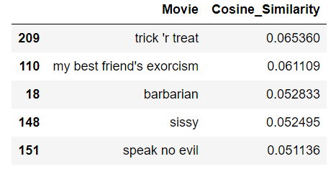
Insights and Recommender System
User wants a movie with the following attributes:
Scary, Funny, Horror
Recommender System generates top 5 movies that user would be subject to watch and enjoy
Business Benefit: To help streaming platforms generalize their content more efficiently for the customer

Slide 14

Thank You!
Questions?

